Slide 1
Research Update
5th April, 2024

Slide 2
ML Approach — Proposed Methodology
ML Approach — Proposed Architectures
Extraction of 12 keypoints from each of the HPE image frames
Mean deviation is performed of each of the coordinates for each keypoint
Multi-Layer Perceptron
4 layers. {4 nodes, 5 nodes, 6 nodes, 4 nodes}
Random Forest Classifier
10-tree forest
Criterion = Gini impurity, Minimum Samples Split = 2.

Slide 3
Research Update
23rd March, 2024

Slide 4
List of Experiments
Training and Testing on Non-Keyframes
Training and Testing on Keyframes
Testing by Class
Training and Testing after Class Balancing

Slide 5
Training and Testing on Non-Keyframes
Methodology
Loading all images from the dataset
Random splitting (seed of 0) in an 8:1:1::train:validation:test split
Upon the completion of training, the best model was saved
Description of Data
Total images = 17038
Training Images = 13630, Validation Images = 1703, Testing Images = 1705
Hyperparameters
They were the same for all architectures
Learning Rate = 5e-5
Loss Function = Cross Entropy
Optimization = Adam
Training Parameters
Early Stopping if Validation Loss does not decrease for 20 epochs
Initially trained for 130 epochs, however, if the Early Stopping condition was not met, the model was trained further

Slide 6
Training and Testing on Keyframes
Methodology
Loading all images from the dataset
Random splitting (seed of 0) in an 8:1:1::train:validation:test split
Upon completion of the training, the best model was saved
Description of Data
Total images = 513
Training Images = 410, Validation Images = 51, Testing Images = 52
Hyperparameters
They were the same for all architectures
Learning Rate = 5e-5
Loss Function = Cross Entropy
Optimization = Adam
Training Parameters
Early Stopping if Validation Loss does not decrease for 20 epochs
Initially trained for 130 epochs, however, if the Early Stopping condition was not met, the model was trained further

Slide 7
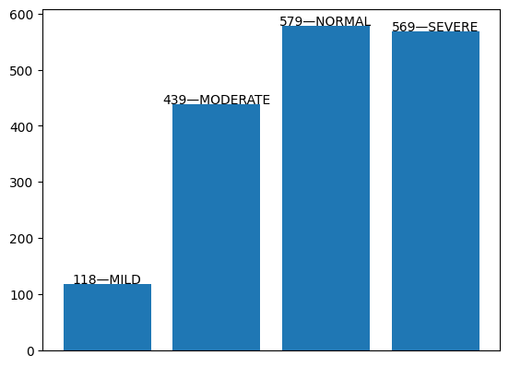
Testing by Class
Methodology
Models trained earlier on slide 4, were loaded
The testing dataset was loaded and divided by class. Each sub-section of the dataset was fed to the model for evaluation
Description of Data
Testing Images = 1705

Slide 8
Training and Testing after Class Balancing
Methodology
Loading all images from the dataset
Oversampling was performed to ensure all classes had the same number of elements
Random splitting (seed of 0) in an 8:1:1::train:validation:test split
Upon the completion of training, the best model was saved
Description of Data (after Class Balancing)
Total images = 23580
Training Images = 18864, Validation Images = 23589, Testing Images = 2358
Hyperparameters
They were the same for all architectures
Learning Rate = 5e-5
Loss Function = Cross Entropy
Optimization = Adam
Training Parameters
Early Stopping if Validation Loss does not decrease for 20 epochs
Initially trained for 130 epochs, however, if the Early Stopping condition was not met, the model was trained further

Slide 9
 | Non-keyframes | Keyframes | Test-by-Class |  |  | Class-Balancing
 |  |  | By Class | Average | Weighted Average
ViT-Tiny | 99.71% | 32.69% | 100.00% | 99.74% | 99.71%
 |  |  | 99.32%
 |  |  | 99.83%
 |  |  | 99.82%
ViT-Small | 99.76% | 32.69% | 100.00% | 99.81% | 99.76% | 99.96%
 |  |  | 99.77%
 |  |  | 99.65%
 |  |  | 99.82%
ViT-Base | 99.70% | 59.63% | 98.31% | 99.43% | 99.70%
 |  |  | 99.77%
 |  |  | 99.83%
 |  |  | 99.82%
ResNet-18 | 99.88% | 67.30% | 100.00% | 99.89% | 99.88% | 100.00%
 |  |  | 99.77%
 |  |  | 100.00%
 |  |  | 99.82%
ResNet-34 | 99.88% | 63.46% | 100.00% | 99.89% | 99.88%
 |  |  | 99.77%
 |  |  | 100.00%
 |  |  | 99.82%
CNN 5-layer | 91.61% | 30.77% | 80.51% | 88.41% | 90.73% | 96.40%
 |  |  | 86.10%
 |  |  | 97.24%
 |  |  | 89.81%
CNN 6-layer | 87.22% | 7.69% | 10.10% | 67.86% | 82.99%
 |  |  | 71.98%
 |  |  | 97.93%
 |  |  | 91.39%

Slide 10
Structure for the Paper
Introduction
Problem of PD
Non-ML methods of detection
ML+DL methods of detection + Issues
Requirement for alternatives
Rationale for this study
Related Works Section
Remote Gait Type Classification System Using Markerless 2D Video
Pose-Based Gait Analysis for Diagnosis of Parkinson’s Disease
3-D Canonical Pose Estimation and Abnormal Gait Recognition With a Single RGB-D Camera
Pathological Gait Classification Using Kinect v2 and Gated Recurrent Neural Networks
Description of Data
On the basis of class
On the basis of training/validation/testing
Methodology
Preprocessing of images
HPE images (standard scaling)
Generation of energy images
Description of Experiments
Non-keyframes
Test by class
Class-balancing
Results
Discussions
Distinction between EIs of different classes
Conclusion
Appendix
Training Plots
Confusion Matrix
Mathematical proof for higher computational efficiency and information communication with EIs.

